Slide 1
Overview slides
April 2023
Notes:
There are 4 variations of the title page created in the Master Slides. To choose another option right click on the slide > Layout > and choose your desired design
To change the background image: Right click on the background image > Format Background > Fill > Picture or texture fill > Picture source > Insert > From a file (or online) > select you image and press Open.

Slide 2


Date: 31 March 2023
Datasets
Hosted portals
83,724
12
Country Participants
64
Peer-review papers
using data
8,565
Organizational Participants
Average records
downloaded per month (2023)
43
163.1 billion
Species
occurrence records
Publishers
1,995
2,295,393,034
https://www.gbif.org
Notes:
Frequently used slide, redone
Please copy and paste these to your slides and never make any changes to them directly in the toolkit.
Useful to see GBIF in its different modalities:
A window on biodiversity
An informatics infrastructure focuseD on tools and standards in service to science and society
A global network on bioinformatics

Slide 3
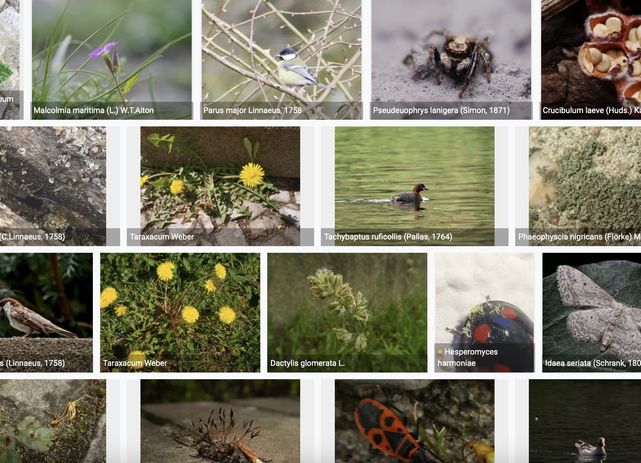
Species occurrence records with multimedia evidence
Date: 31 March 2023
134.7 million records with taxonomically identified images
80.7 million human observations
50.9 million specimens
1.4 million fossil specimens
1.1 million material samples
1,096,309 audio files
4,558 videos
https://www.gbif.org/occurrence/gallery

Slide 4
GBIF Participant countries
Date: 31 March 2023
Voting Participants
Associate Participants
Notes:
This map is fully editable. This map is a grouped element of all the countries in the world. All the countries are named correctly and can be accessed and selected via the Selection Pane.
There are ways you can edit and make changes to the map. But please remember to always make a copy of the map on your slide and never make changes to the toolkit version.
Please take a look at the next few slides to find out different ways of editing this map

Slide 5
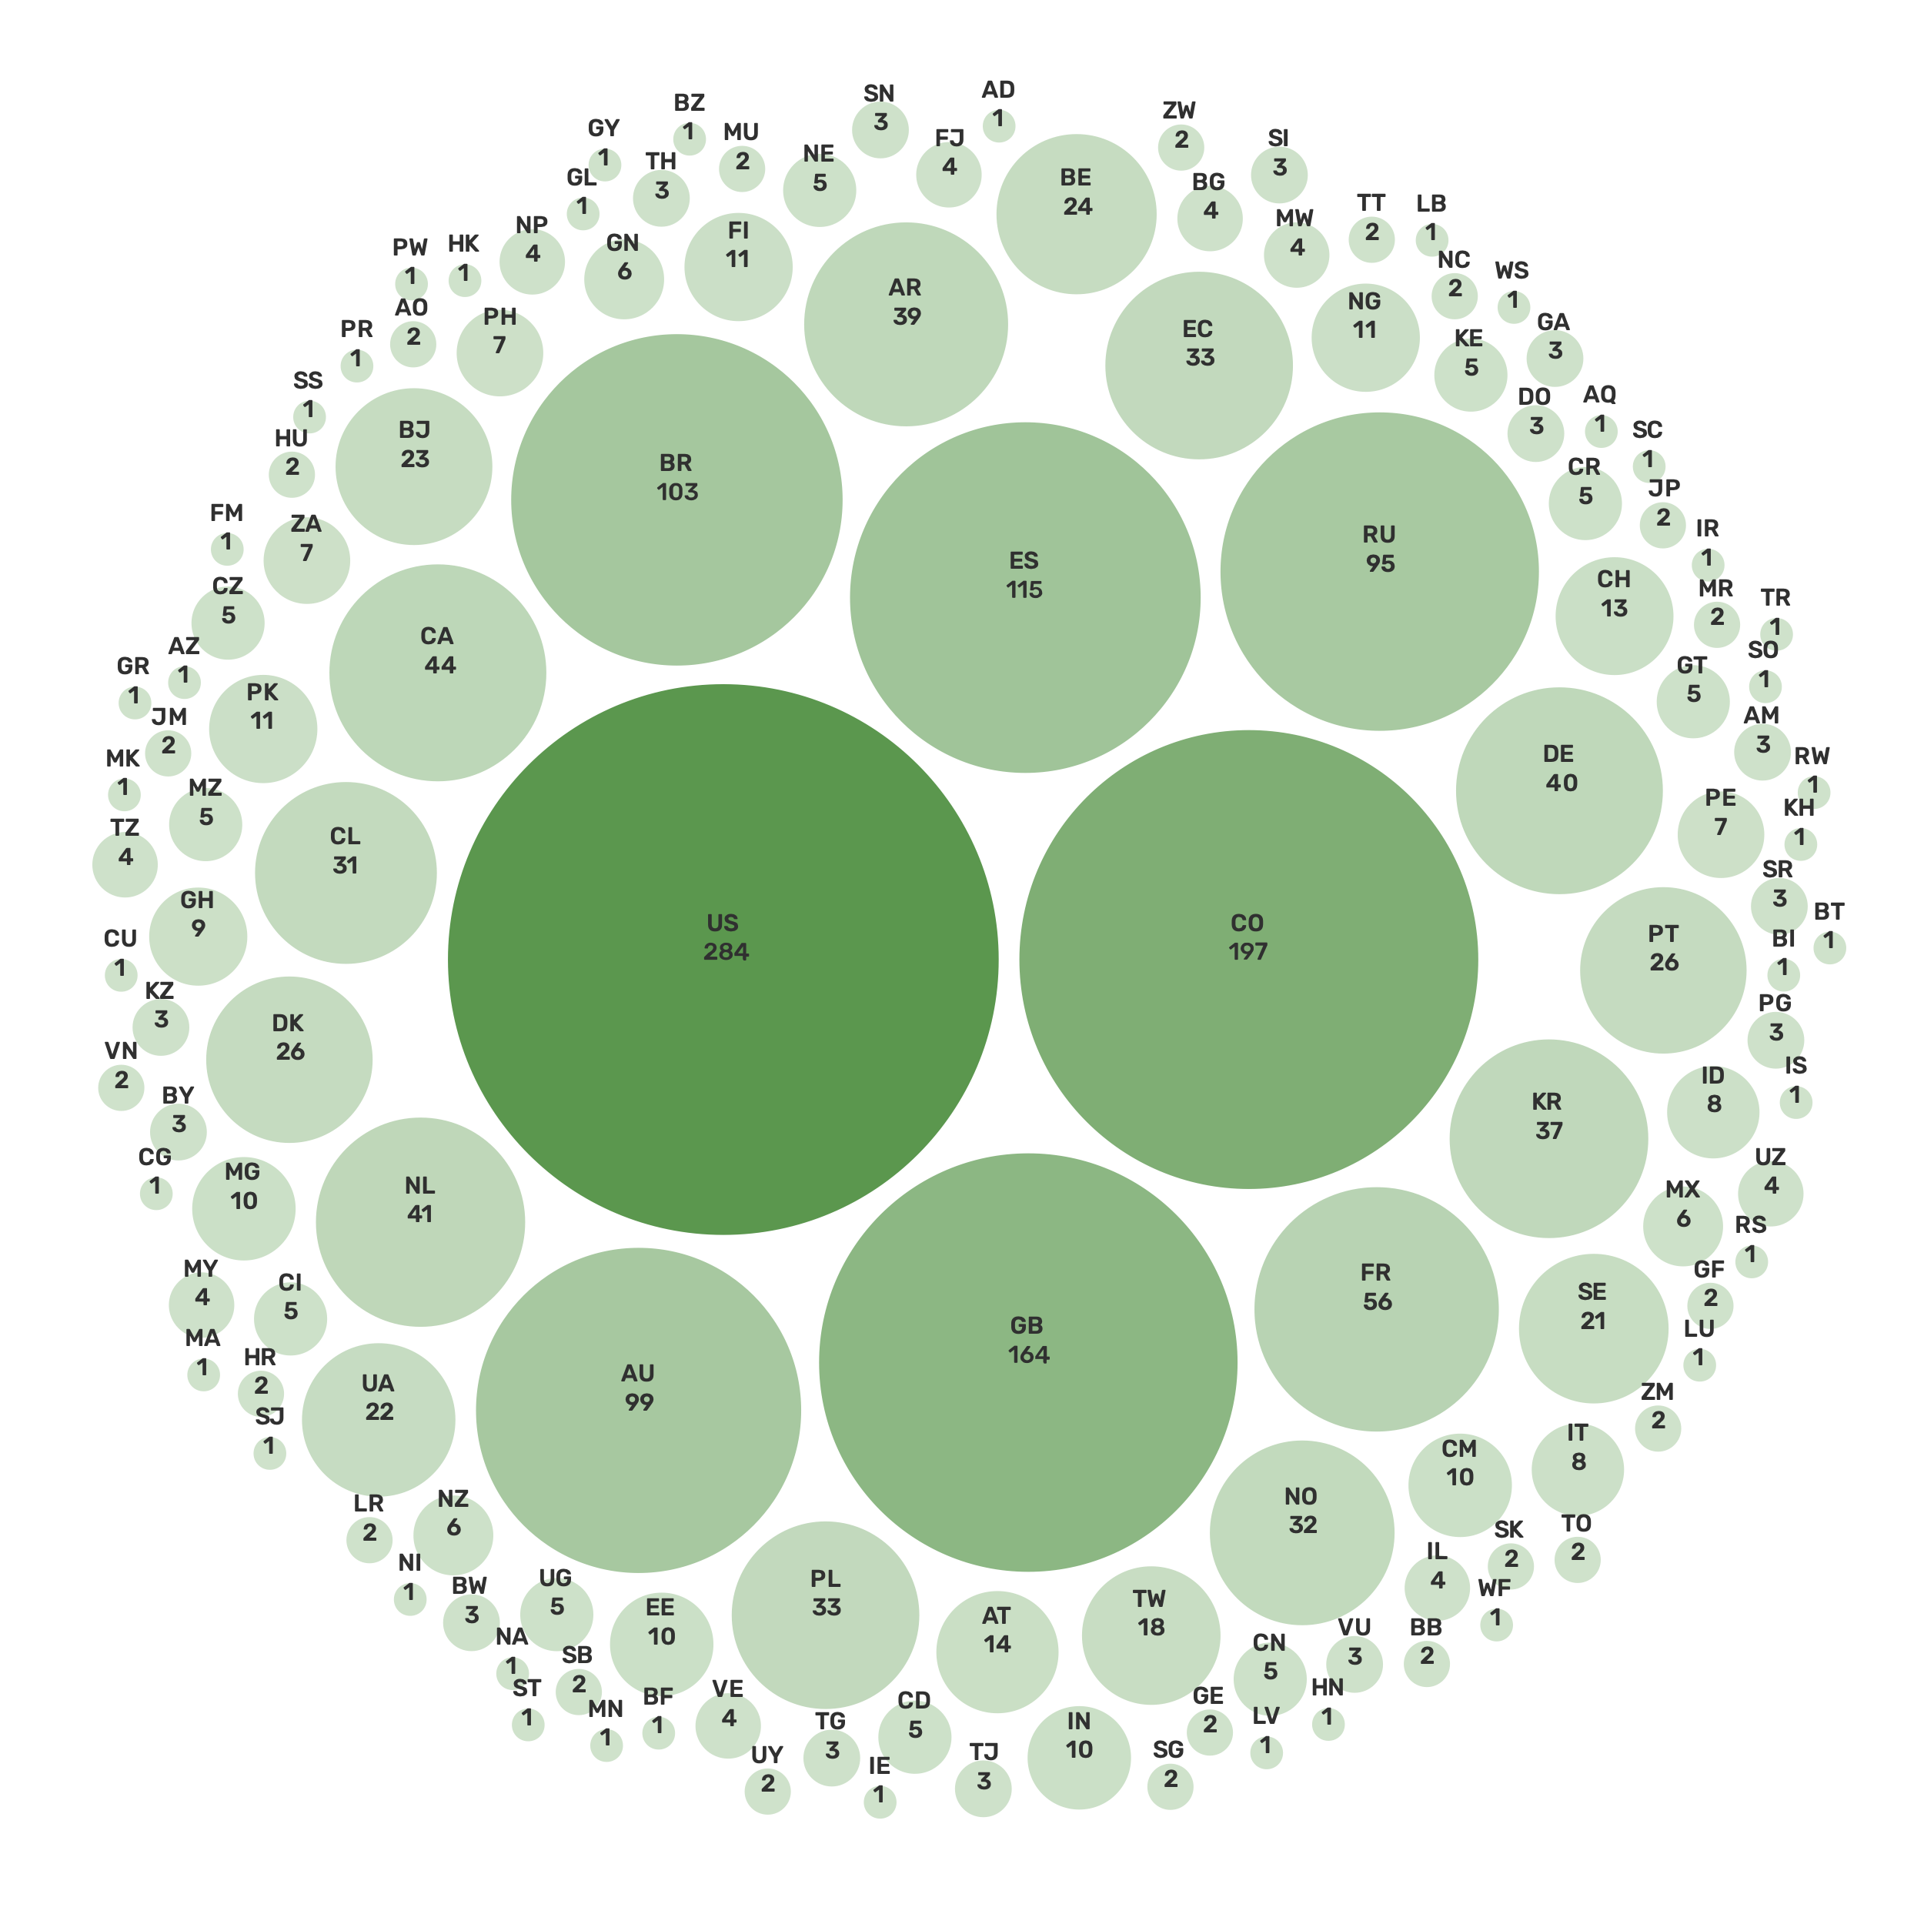
GBIF network of data publishing institutions
Date: 31 March 2023
135
countries/areas with institutions sharing data through GBIF

Slide 6
GBIF.org traffic by country
Date: 31 March 2023
Rank | Country/Territory | Visitors | Visits | Effective visits* | % Effective visits | 2022 rank | Pages / session
1 | United States | 152,204 | 184,639 | 84,934 | 11.47% | 1 | 5.74
2 | Mexico | 73,812 | 87,562 | 35,900 | 4.85% | 3 | 5.57
3 | Colombia | 69,537 | 89,613 | 40,325 | 5.44% | 2 | 4.46
4 | Brazil | 59,556 | 72,156 | 32,470 | 4.38% | 4 | 4.61
5 | India | 76,449 | 181,399 | 97,339 | 5.19% | 10 | 6.86
6 | Spain | 41,158 | 167,951 | 116,709 | 6.22% | 5 | 12.91
7 | Germany | 53,966 | 119,079 | 58,920 | 3.14% | 9 | 5.58
8 | France | 50,267 | 115,731 | 61,222 | 3.26% | 7 | 6.37
9 | China | 49,357 | 114,235 | 57,323 | 3.06% | 6 | 6.77
10 | United Kingdom | 43,633 | 109,329 | 55,299 | 2.95% | 8 | 6.05
 | TOTAL | 1,225,897 | 1,543,368 | 802,551 | 100.00% |  | 6.01

Slide 7
Occurrences published annually by country
Date: 31 March 2023
Rank | Country/Territory | 2023 | 2022 total | 2022 rank
1 | United States | 6,841,141 | 123,152,046 | 1
2 | France | 4,144,385 | 40,243,552 | 2
3 | Canada | 3,003,702 | 22,328,115 | 4
4 | Sweden | 2,553,019 | 13,698,583 | 7
5 | Netherlands | 2,428,511 | 30,330,743 | 3
6 | Poland | 1,638,425 | 2,542,166 | 20
7 | Australia | 1,629,675 | 18,787,368 | 5
8 | Norway | 1,089,243 | 4,219,495 | 14
9 | Denmark | 1,087,369 | 3,337,598 | 17
10 | Estonia | 770,685 | 8,054,503 | 9
OTHER COUNTRIES + AREAS | OTHER COUNTRIES + AREAS | 31,249,554 | 66,653,115
TOTAL |  | 56,435,709 | 369,598,387
Notes:
This is a live doughnut pie chart representing different theme colours and how they work, placed next to one another.
You do not have to use the same exact chart, you can simply create your own by clicking on:
Insert tap on the ribbon > Click on Chart > chose a chart of your choice (in this example I chose, Doughnut) > add in your data in the automatically opened Excel sheet and see your chart changing and adopting to the new information you have entered in the data sheet.

Slide 8
Data download requests
Date: 31 March 2023
Rank | Country |  | 2023 | 2022 total | 2022 rank
1 | United States | 9,840 |  | 24,812 | 3
2 | China | 9,269 |  | 36,844 | 1
3 | Mexico | 6,021 |  | 27,172 | 2
4 | Brazil | 5,352 |  | 14,777 | 5
5 | Colombia | 4,406 |  | 18,392 | 4
6 | Spain | 3,924 |  | 9,280 | 7
7 | United Kingdom | 3,333 |  | 10,256 | 6
8 | France | 2,980 |  | 5,231 | 9
9 | Canada | 1,964 |  | 4,782 | 10
10 | Belgium | 1,739 |  | 1,725 | 25
OTHER COUNTRIES + AREAS | ALL OTHERS | 23,519 |  | 75,107
TOTAL |  | 72,347 |  | 232,591
127
countries, islands & territories where users have requested downloads (+5)
Notes:
NB: 2022 totals account for multiple recurrent downloads by scripts and bots that are discarded, accounting for (in Jan 2022):
Argentina: 1,592
Austria: 1,032
Belgium: 1,377
Canada: 1,648
Switzerland: 49,358
China: 13,498
India: 3,579
Japan: 124,927
Netherlands: 28,857
Norway: 3,615
United States: 51,186

Slide 9
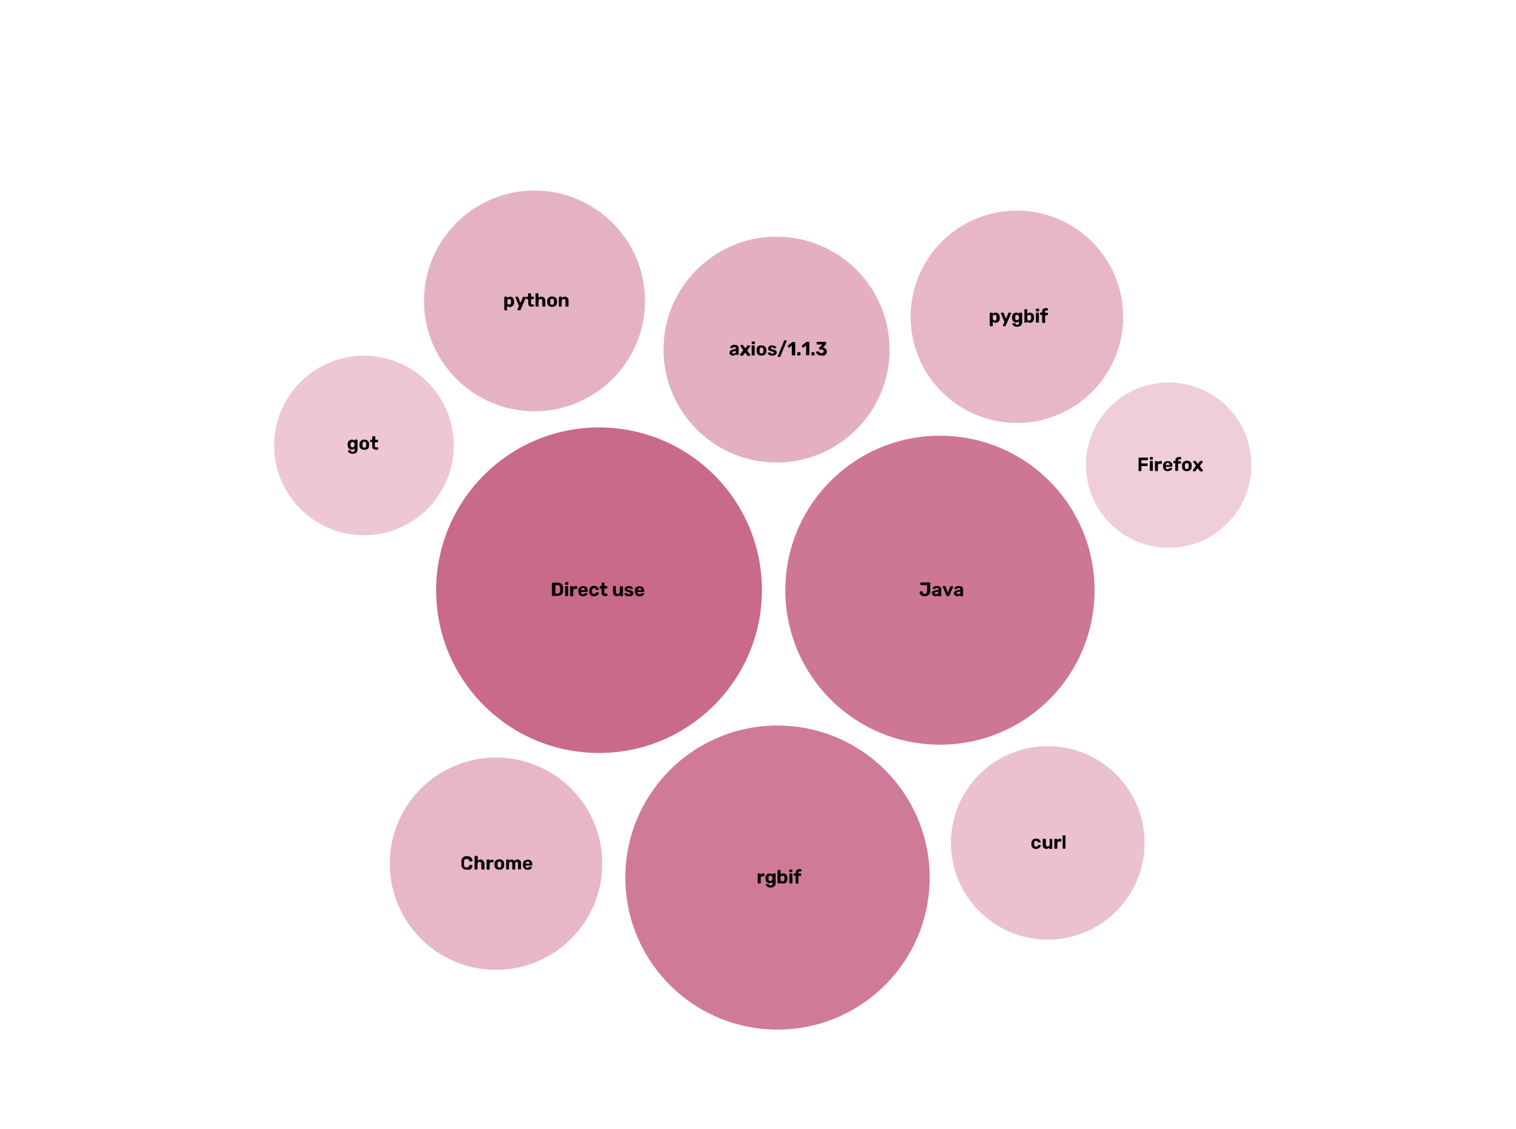
API requests per agent (2022)
Date: 2022
275,240,168
API requests
Agent | Requests
Direct use | 38,992,030
Java | 35,176,955
rgbif | 34,074,909
axios/1.1.3 | 18,762,933
python | 17,944,092
pygbif | 16,585,720
Chrome | 16,583,277
curl | 13,792,673
got | 11,878,832
Firefox | 10,058,577
Notes:
NB: 2022 totals account for multiple recurrent downloads by scripts and bots that are discarded, accounting for (in Jan 2022):
Argentina: 1,592
Austria: 1,032
Belgium: 1,377
Canada: 1,648
Switzerland: 49,358
China: 13,498
India: 3,579
Japan: 124,927
Netherlands: 28,857
Norway: 3,615
United States: 51,186

Slide 10
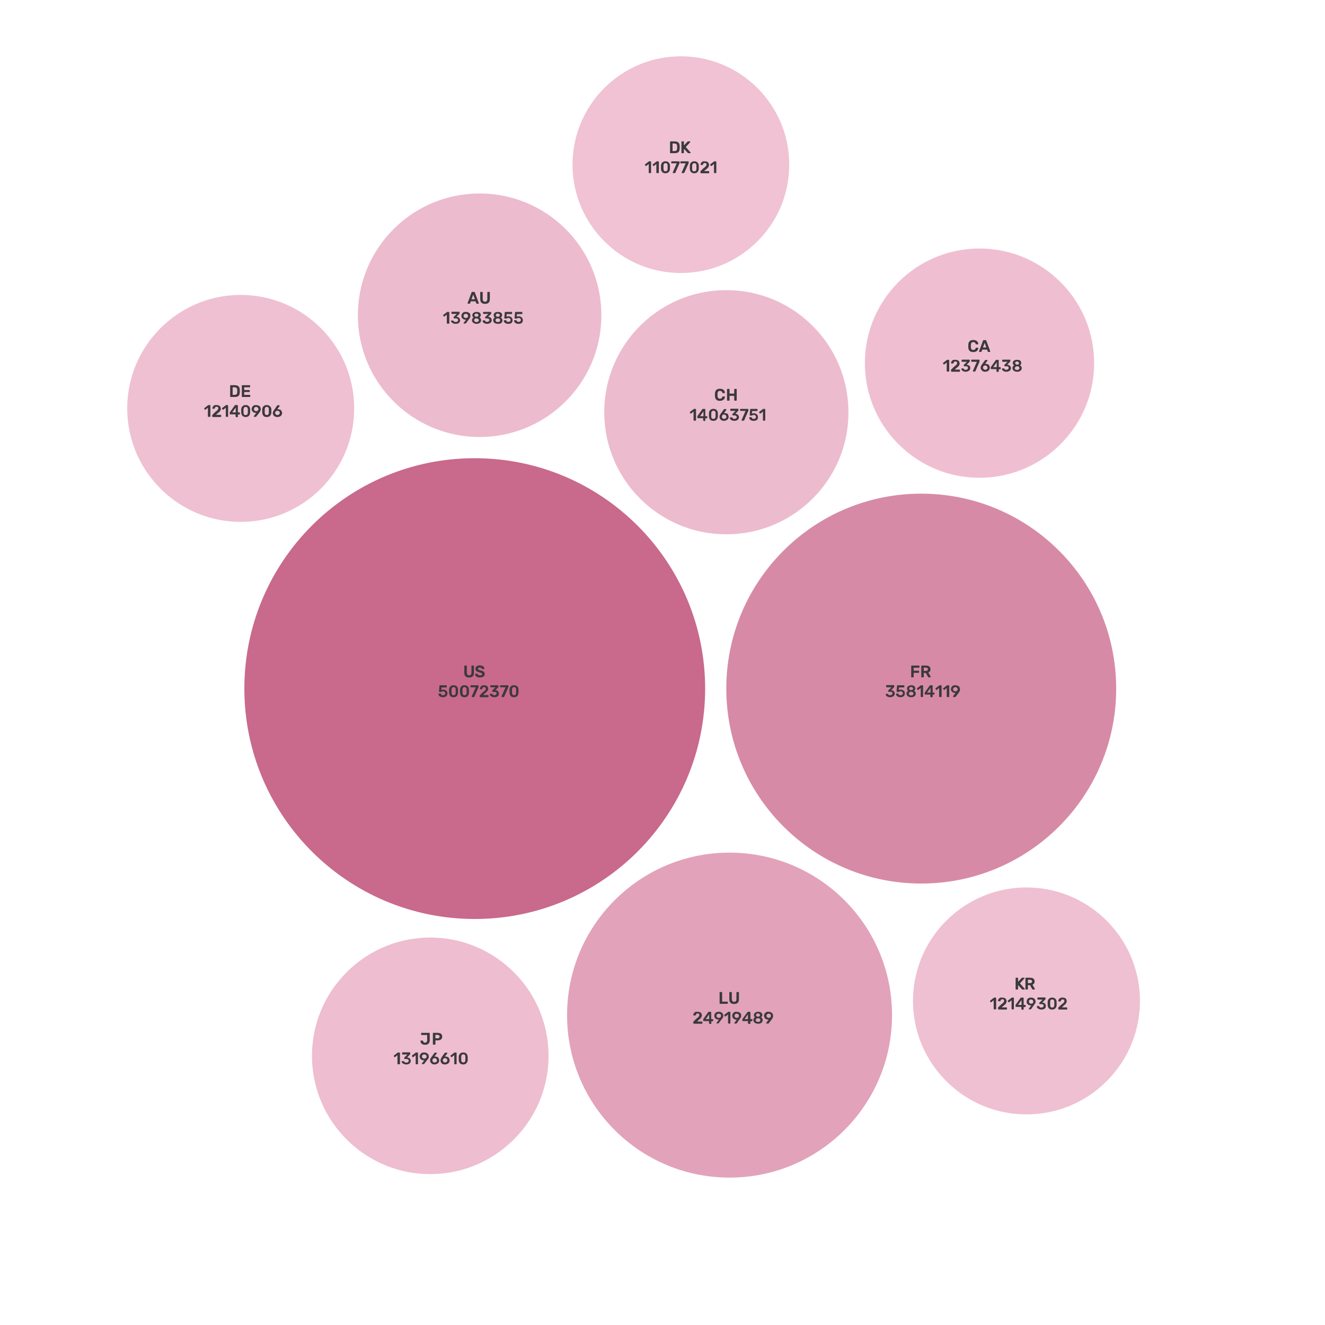
API requests per country (2022)
Date: 2022
275,240,168
API requests
Agent | Requests
United States | 50,072,370
France | 35,814,119
Luxembourg | 24,919,489
China | 14,063,751
Australia | 13,983,855
Japan | 13,196,610
Canada | 12,376,438
South Korea | 12,149,302
Germany | 12,140,906
Denmark | 11,077,021
Notes:
NB: 2022 totals account for multiple recurrent downloads by scripts and bots that are discarded, accounting for (in Jan 2022):
Argentina: 1,592
Austria: 1,032
Belgium: 1,377
Canada: 1,648
Switzerland: 49,358
China: 13,498
India: 3,579
Japan: 124,927
Netherlands: 28,857
Norway: 3,615
United States: 51,186

Slide 11
Peer-reviewed publications using GBIF-mediated data
Date: 31 March 2023
Notes:
The next 3 slides are showcasing PPT standard or Live charts.
To create a chart simply click on the Insert tap on the ribbon > Click on Chart > chose a chart of your choice (in this example I chose, Bar) > add in your data in the automatically opened Excel sheet and see your chart changing and adopting to the new information you have entered in the data sheet.

Slide 12
Data Use in peer-reviewed journals
Date: 31 March 2023
Peer-reviewed uses by country
Peer-reviewed uses by region
End of Year |  |  | 2023 total | 2022 total | 2022 rank
1 | China |  | 92 | 309 | 1
2 | United States |  | 78 | 306 | 2
3 | Brazil |  | 46 | 167 | 3
3 | United Kingdom |  | 46 | 149 | 4
5 | Germany |  | 40 | 126 | 6
6 | Mexico |  | 35 | 146 | 5
7 | France |  | 30 | 78 | 7
7 | Spain |  | 30 | 105 | 9
9 | India |  | 27 | 63 | 12
9 | Australia |  | 27 | 78 | 8
Notes:
This is a live doughnut pie chart representing different theme colours and how they work, placed next to one another.
You do not have to use the same exact chart, you can simply create your own by clicking on:
Insert tap on the ribbon > Click on Chart > chose a chart of your choice (in this example I chose, Doughnut) > add in your data in the automatically opened Excel sheet and see your chart changing and adopting to the new information you have entered in the data sheet.

Slide 13
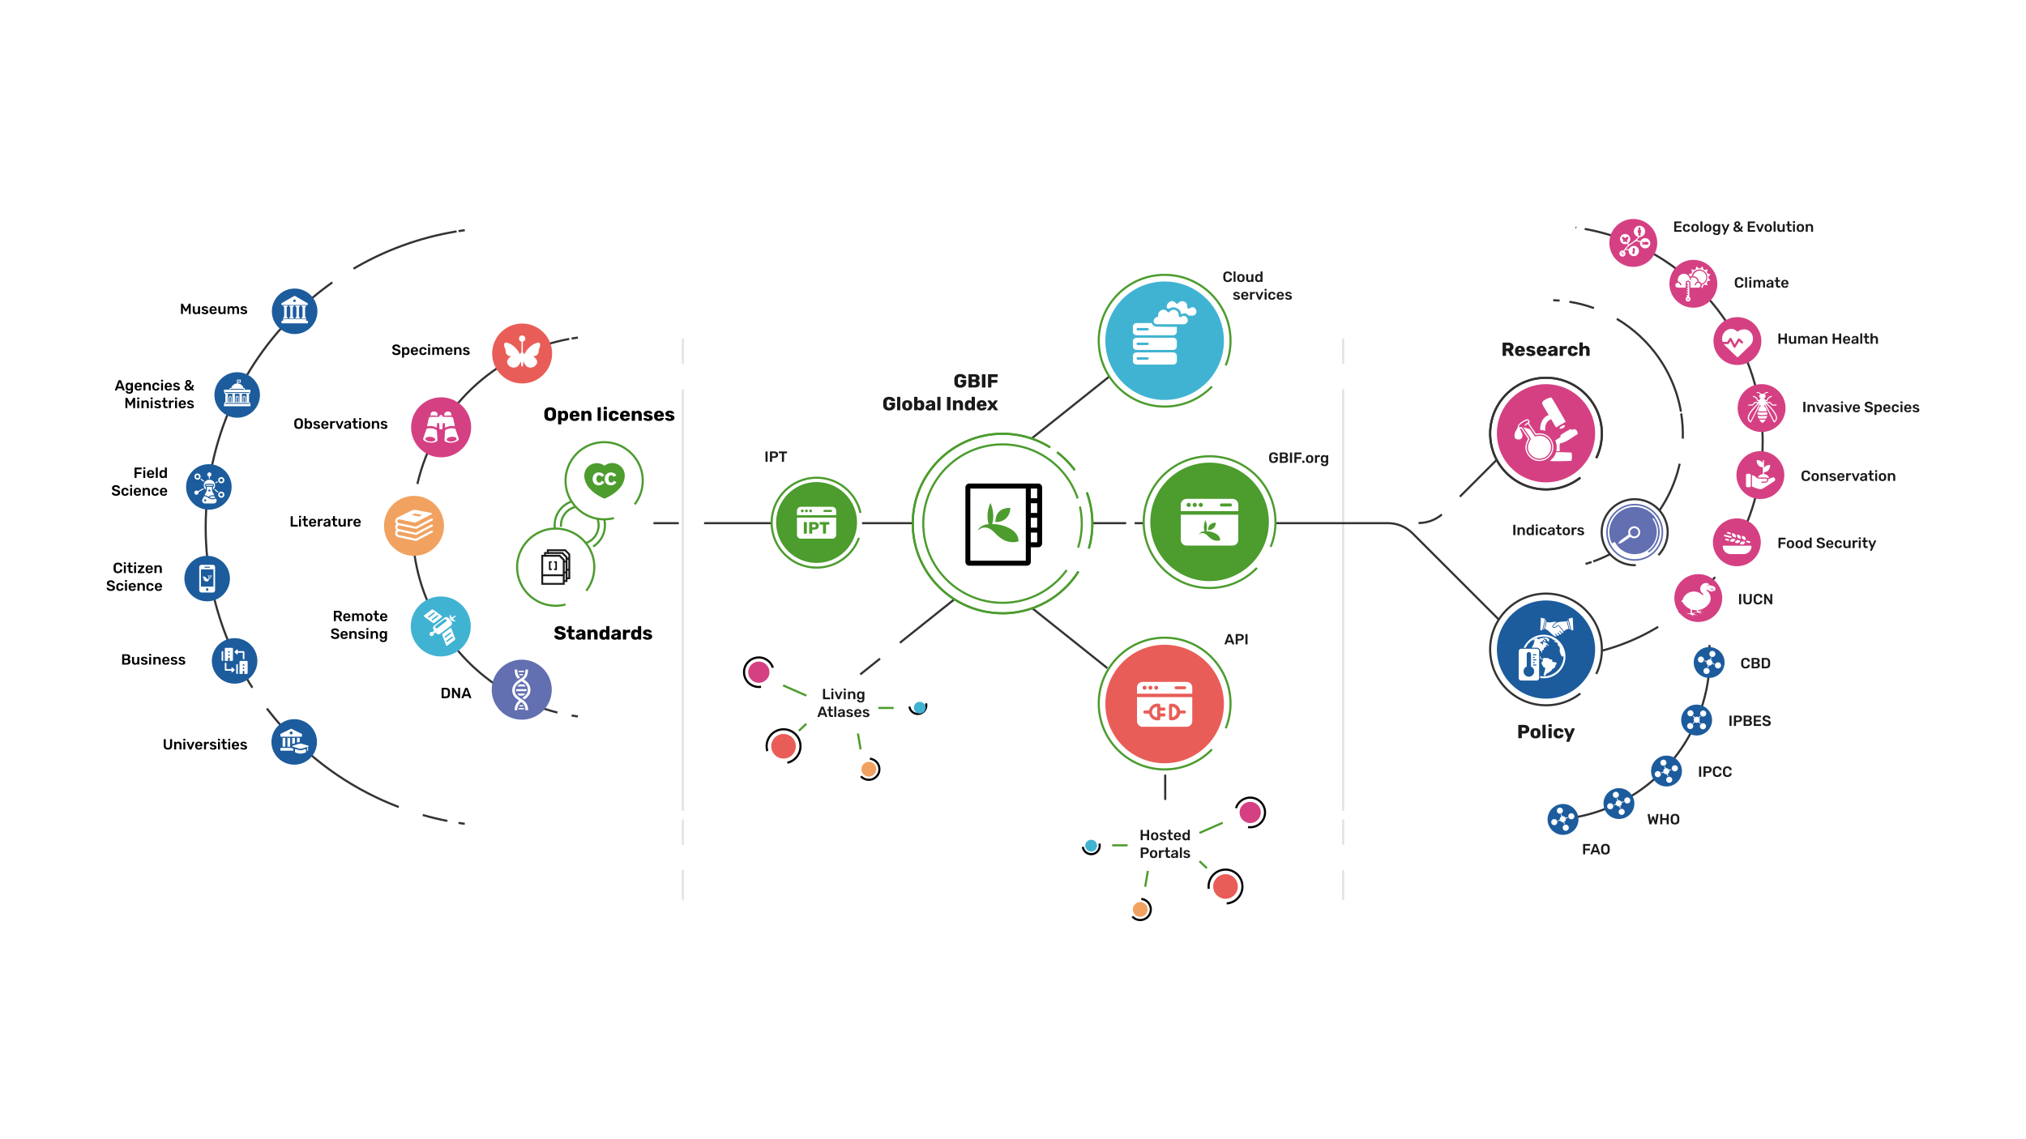
Providing biodiversity evidence for research and policy

Slide 14
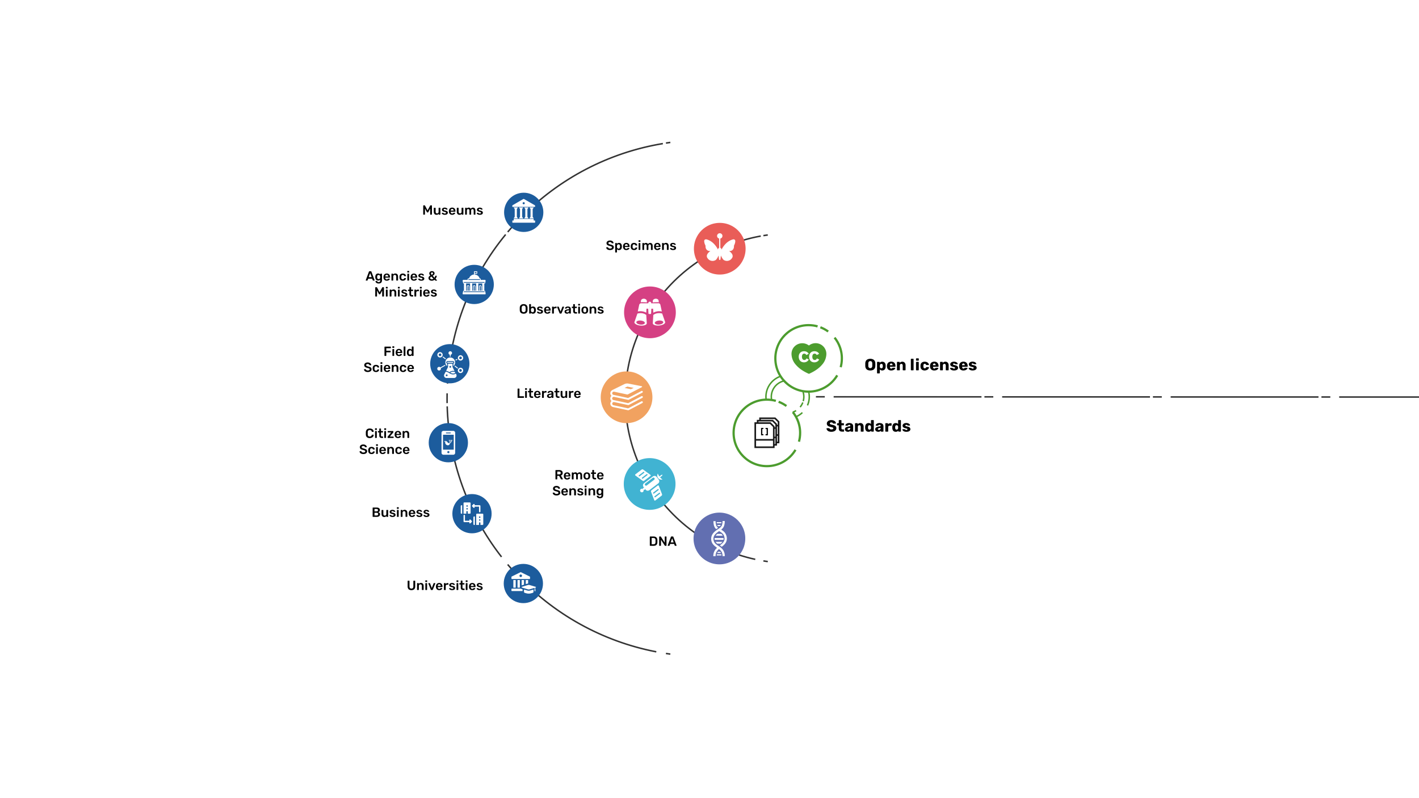
Sources of biodiversity evidence
Create
Combine sources of evidence

Slide 15
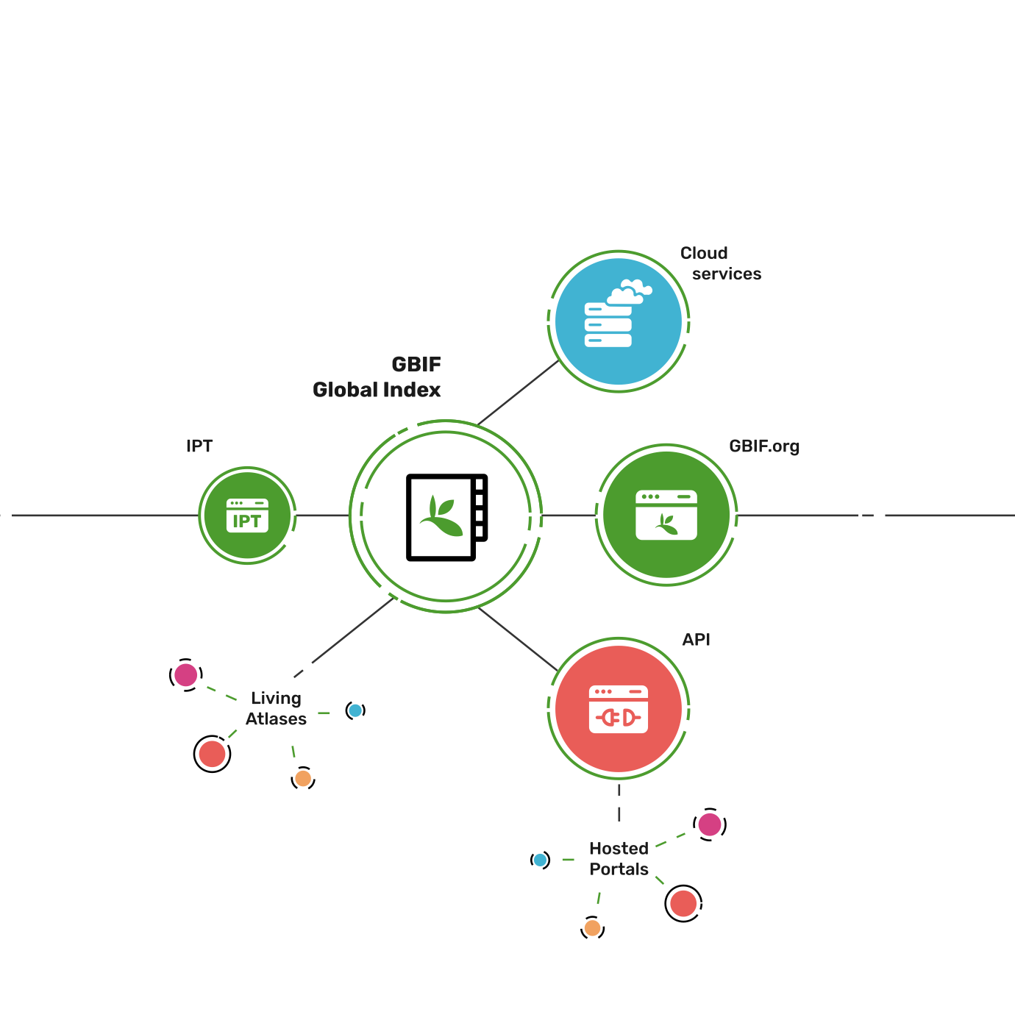
Access to biodiversity evidence
Share
FAIR and open access

Slide 16
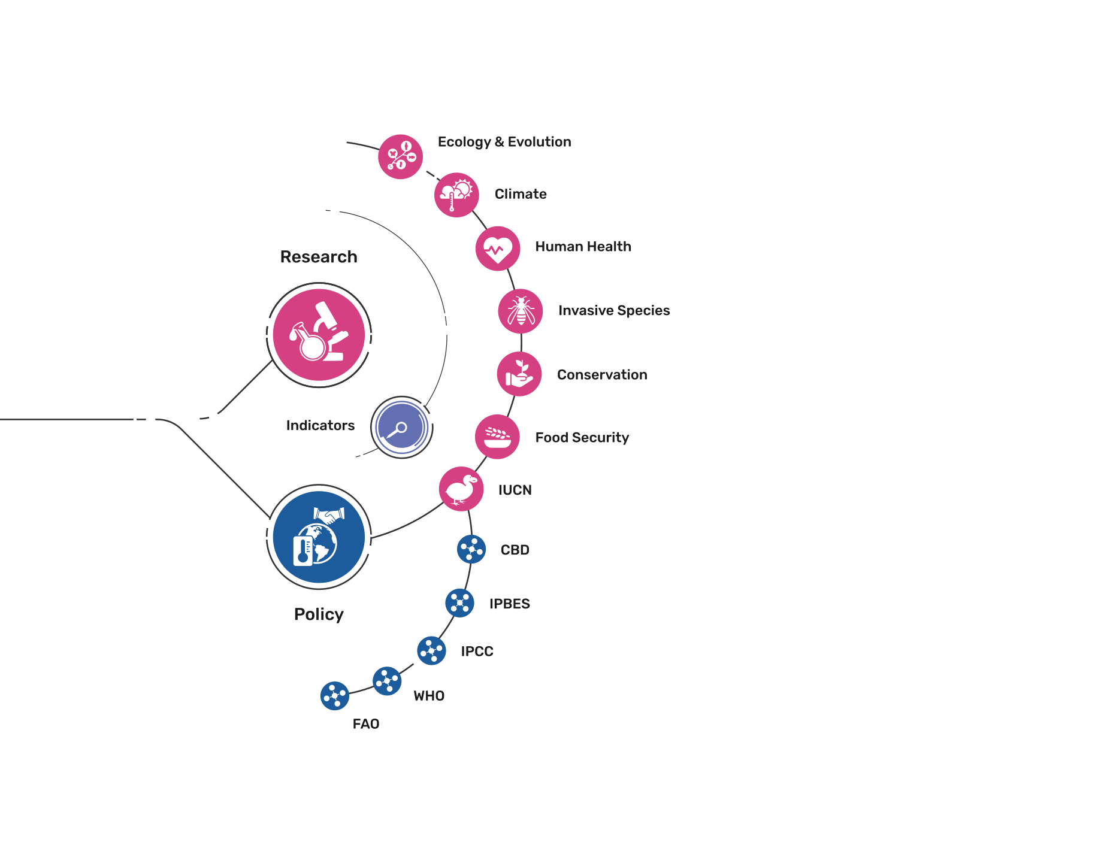
Uses of biodiversity evidence
Transform
Apply and use data

